Slide 1
The Bud Light Controversy
Ellen Mason and Dylan Koenig

Slide 2
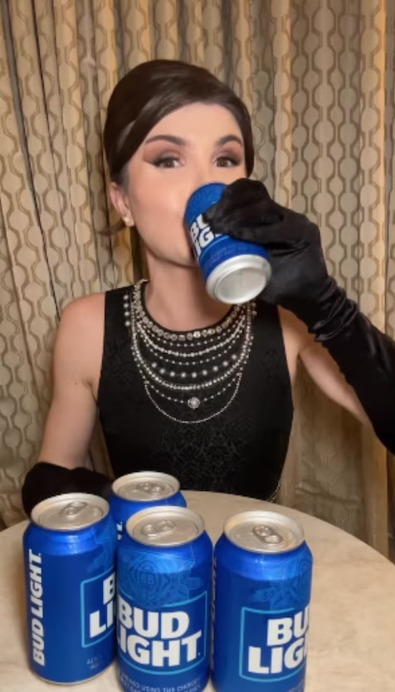
The Situation
In March of 2023 Bud Light partnered with transgender influencer Dylan Mulvaney for the Super Bowl
Dylan was attacked on social media and on the news by anti-trans Bud Light fans
Those who attacked her online began to boycott the beer

Slide 3
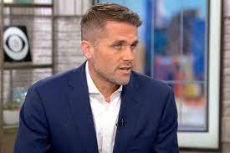
The Dilemma
There have been calls for the Bud Light Ceo, Brendan Whitworth, to step down over his silence on the subject
Does the Ceo take action in someway concerning the sponsorship or step down to appease boycotters and improve the falling sales?

Slide 4
First Amendment or Ethical Dilemma?
The sponsorship has caused Dylan and other members of the LGBTQ to receive violent threats online but the sponsorship shows support for a often attacked marginalized group
It has also but the everyday employees at Bud Light at risk as those at the bottom of the company will be the first to lose their jobs if sales continue to fall

Slide 5
Paradigm
Individual Vs Community
The individual - The Ceo and the Anheuser Busch Company
The community - The LGBTQ Community and those who support it
Should the Ceo prioritize the company’s profits or supporting the LBGTQ community against online backlash

Slide 6
Philosophy
Kant’s Categorical Imperative would say he should show support for Dylan and stand up for equality because this is what everyone should do
We would want everyone to support those who need it and not prioritize money over people
The actor - Ceo Brendan Whitworth

Slide 7
Sources
https://www.cnn.com/2023/06/29/tech/dylan-mulvaney-bud-light-statement/index.html
https://www.nbcnews.com/news/us-news/anheuser-busch-ceo-says-company-will-continue-support-lgbtq-community-rcna91674

